Slide 1
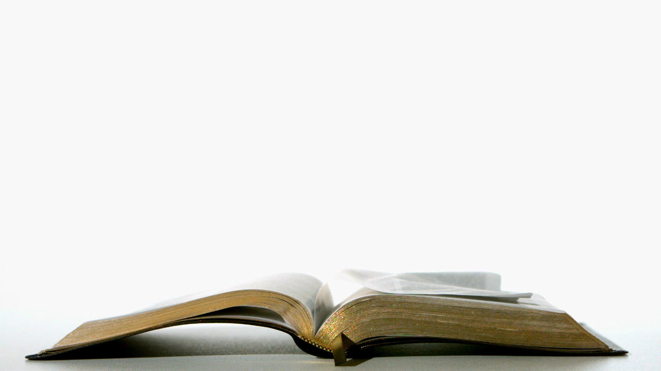
Why the Truth Matters
Media Literacy introduction - lesson 1

Slide 2
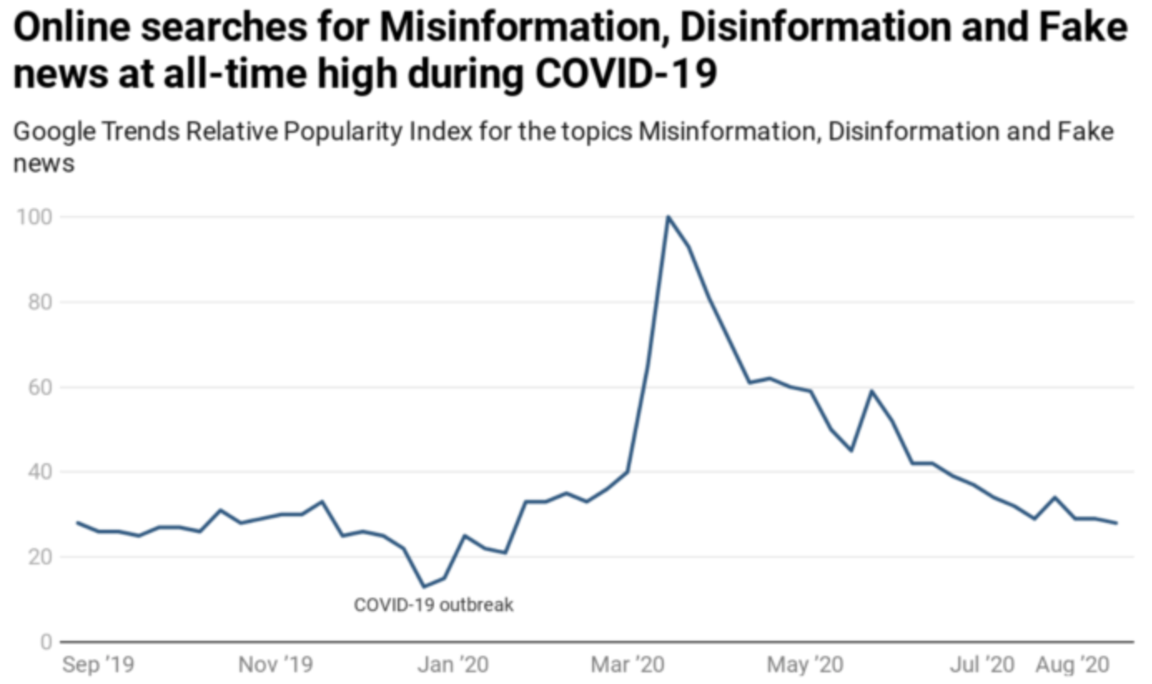
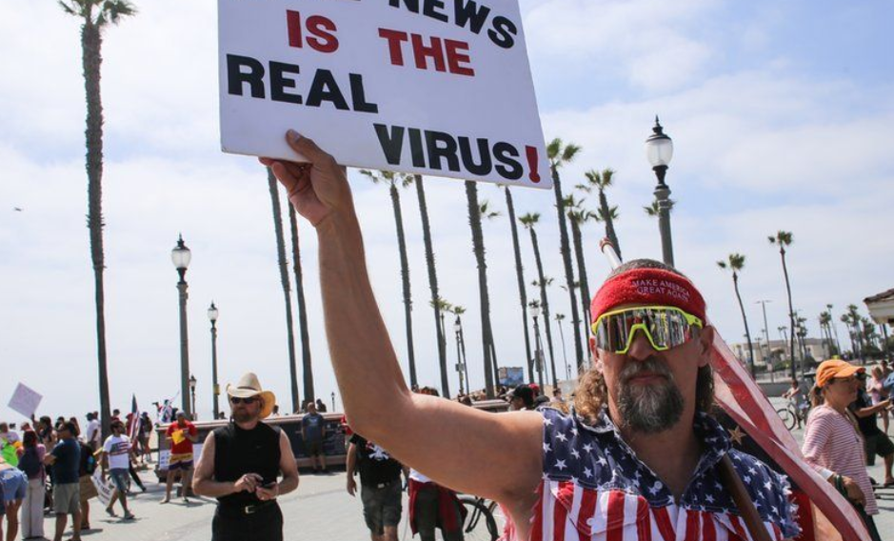
The Disinformation ‘Pandemic’
It has never seemed more difficult to get to the ‘Truth’ of what is happening in the world around us as different sources of news compete to give us very different views of the world around us.
What topics do you know about from the news recently where there are very different opinions about the truth?
Is it easy to tell where the truth lies?

Slide 3
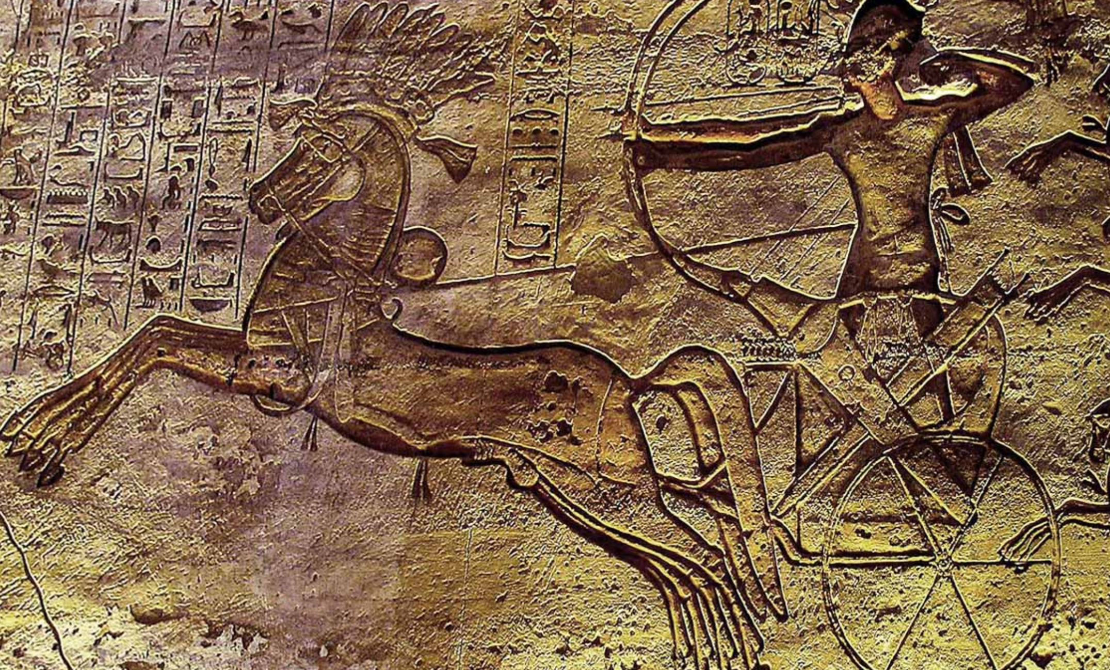
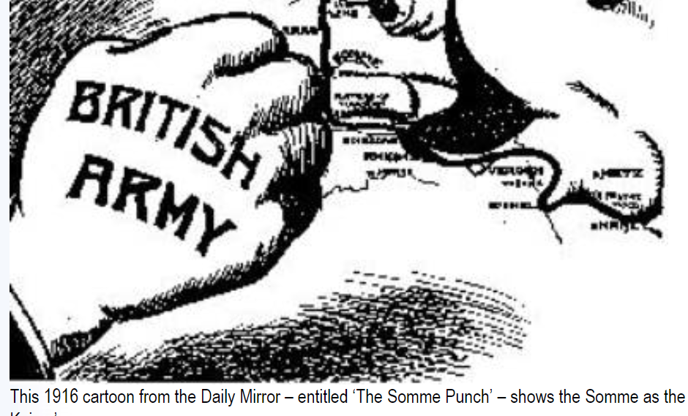
The historical background
Ramasses and the battle of Kadesh 1274 BC which he claimed to win
For thousands of years people, often rulers, have tried to control what people know of events for their own benefit while others have tried to give an objective account of events. This is a conflict that can be seen throughout written human history.
Here are presented the results of the inquiry carried out by Herodotus of Halicarnassus. The purpose is to prevent the traces of human events from being erased by time, and to preserve the fame of the important and remarkable achievements produced by both Greeks nd non-Greeks; among the matters covered is, in particular, the cause of the hostilities between Greeks and non-Greeks.
— Herodotus, The Histories c430BC
How far do you think anyone is capable of giving a fully objective View of events even if they are trying to be fair?

Slide 4
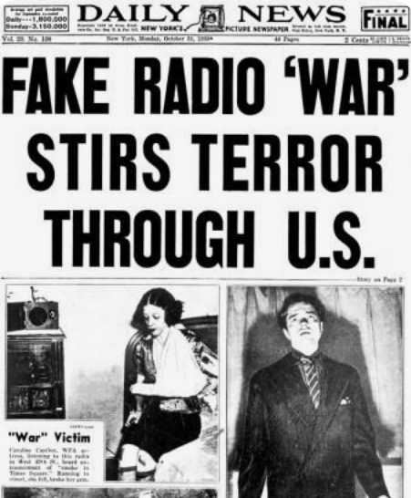
The Impact of Modern Technology
What has changed is the extent to which modern technology can be used to create extremely convincing false news and information and spread that to a huge amount of the population almost instantaneously.
A famous case of this came in 1938 when the director Orson Welles put on a version of the War of the Worlds in the form of fake news bulletins describing a Martian invasion of New Jersey.
Listeners from all over the country called the police and radio stations in panic, although ironically the story that there was nationwide hysteria and even suicides was partly ‘fake news’

Slide 5
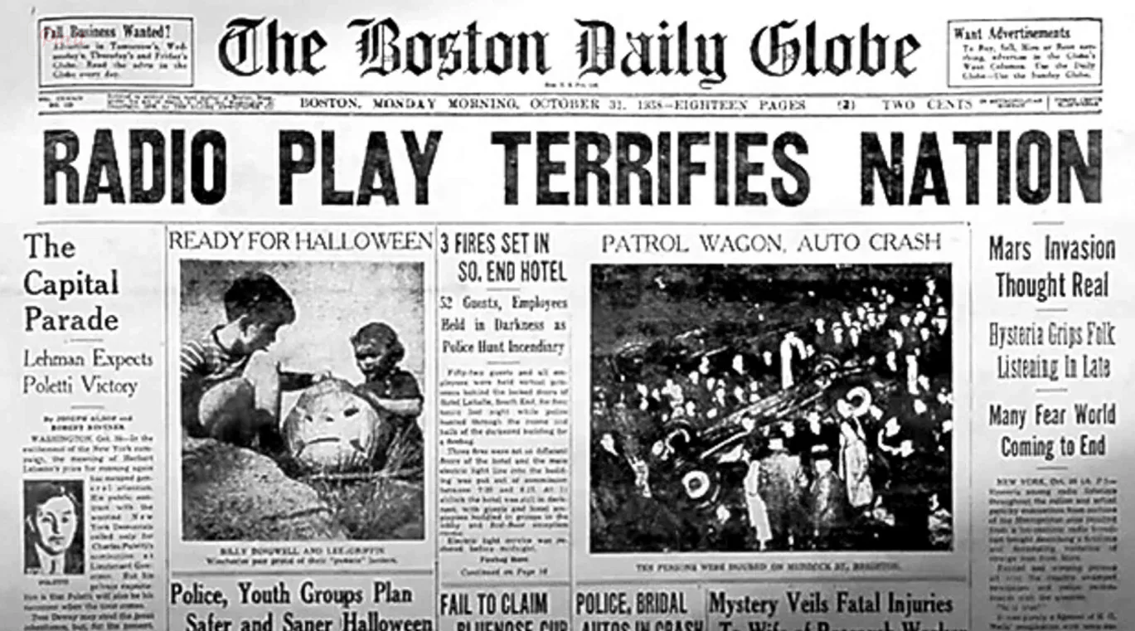
With every new communication technology that is invented, from radio to television to internet to social media, Instagram and tiktok societies have worried about the impact that these technologies will have on their citizens.
The War of the Worlds had a real-world impact, although less dramatic than journalists of the time reported. Welles described Radio itself as ‘the invader of your living room’ and psychologists were soon trying to understand how this new medium seemed to have such a strong power over its listeners.
Do you think the repeated concerns expressed about any new technologies arise, especially with their impact on young people means that these concerns are not valid?

Slide 6
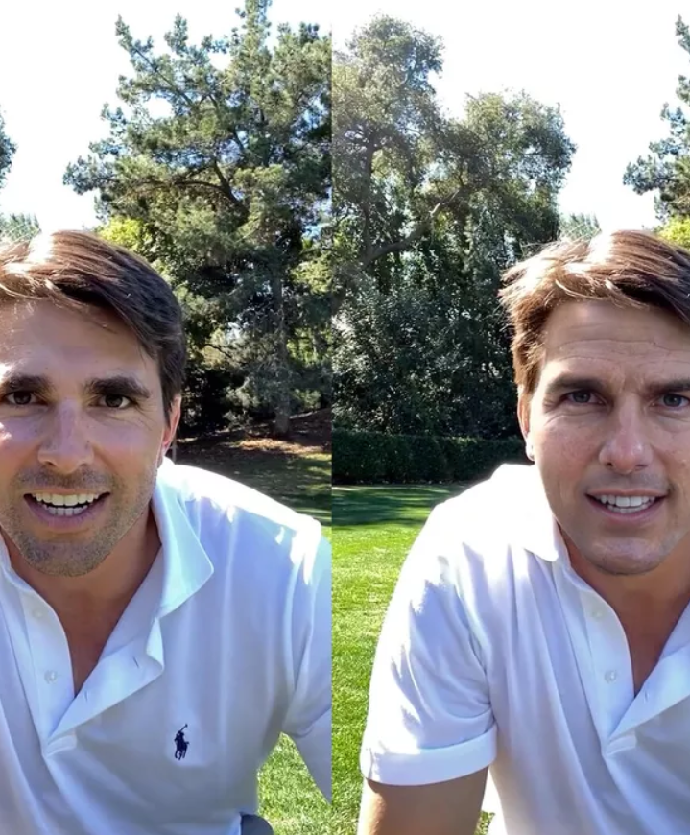
Eighty years or so after the War of the Worlds we are all able to broadcast our views and ideas about the world to anybody who will listen, as can any company or organisation. In addition as technology improves the ability to falsify information through manipulation of sounds, pictures and video as well as words it becomes ever harder to identify which might be the true depiction of events.
Would you be able to tell that this is not the real Tom Cruise if you weren’t told?
(Here is how it works)

Slide 7
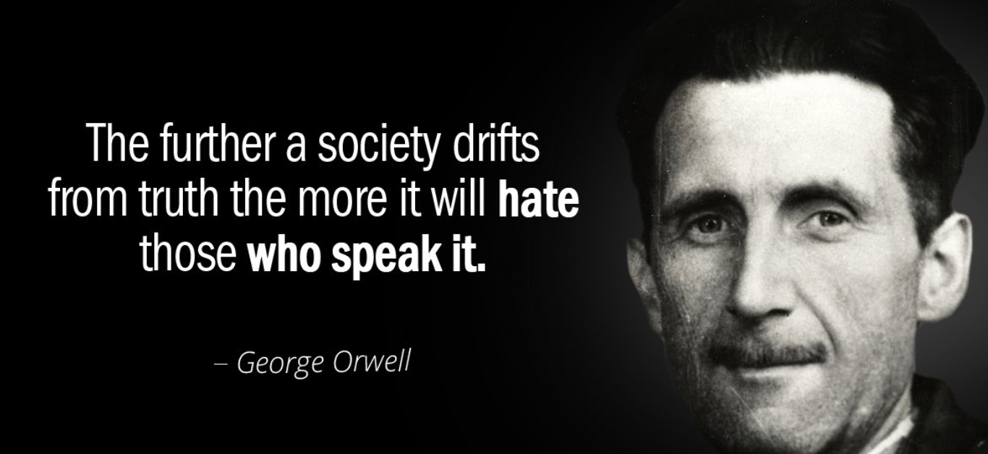
So if everyone can create their own content and we all (in most countries) have mass and unfettered access to the internet why does all this matter? What do you think?

Slide 8
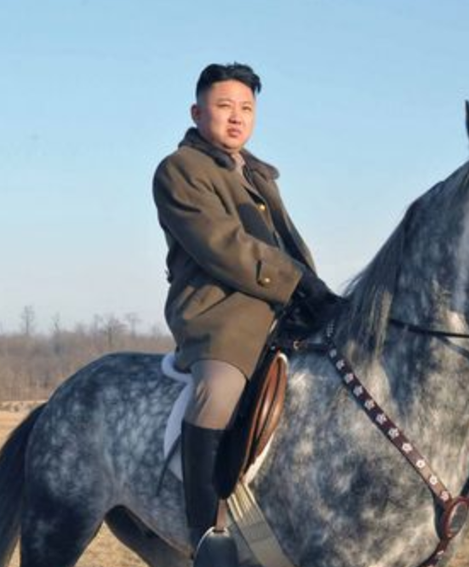
Problem no 1 – ‘They’re all as bad as each other’
Even if false claims and ‘fake news’ are not themselves believed by most people they cast doubt on all the news that is produced. If there is a general confusion about what news is inaccurate or inaccurate many people end up feeling far less trusting of news that is carefully edited and fact-checked. In this way inaccurate news can ‘pollute’ all news sources and make them all seem equally untrustworthy.
To give a comic example the People’s Daily newspaper in China believed without question that the satirical news site ‘The Onion’ that Kim Jong-Un had been voted the sexiest man alive!

Slide 9
Problem 2 - A disinformation ‘arms race
Another problem with the growing problem of inaccurate news is that there will become an ‘arms race’ by different companies and countries. As they realise that one country has got away with one untruth, they will seek to benefit by creating even more ‘fake news’ of their own.

Slide 10
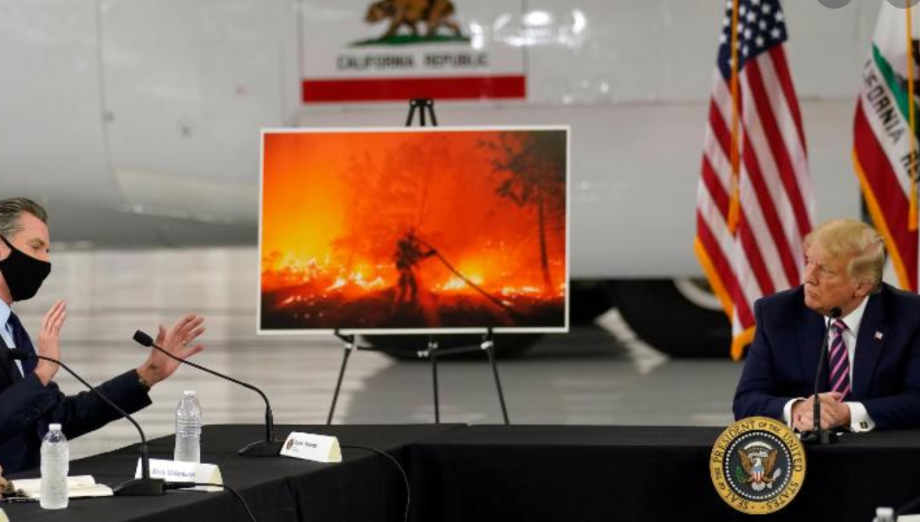
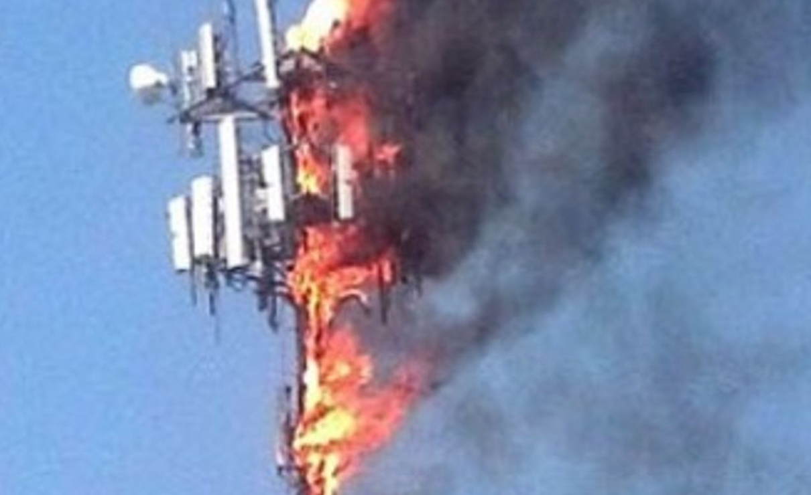
Problem 3 – Real World consequences
Perhaps most serious of all is the fact that people being led to believe falsehoods can have very serious real-life consequences, from climate change denial to spurious reports that mobile phone masts cause covid! This is another very famous example.

Slide 11
Problem 4 – Legislation against ‘fake news’ can be an even bigger problem
Many people fear that the biggest danger though is that governments that want to control all elements of the media and internet will use the excuse of legislating to stop ‘fake news’ as a way of silencing all freedom of expression. This is shown in this news story from China.

Slide 12
So is the situation hopeless?
An article by Professor Charlie Beckett written in 2017 noted that journalists can fight back against fake news and show how important their role is:
‘Fake news it the best thing that has happened for decades. It gaves mainstream quality journalism the opportunity to show that it has value based on expertise, ethics, engagement and experience. It is a wake-up call to be more transparent, relevant and add value to people’s lives.’
This can be seen in the five core principles of journalism stated by the Ethical Journalism Network (and a similar set of principles set out by The Trust Project)

Slide 13
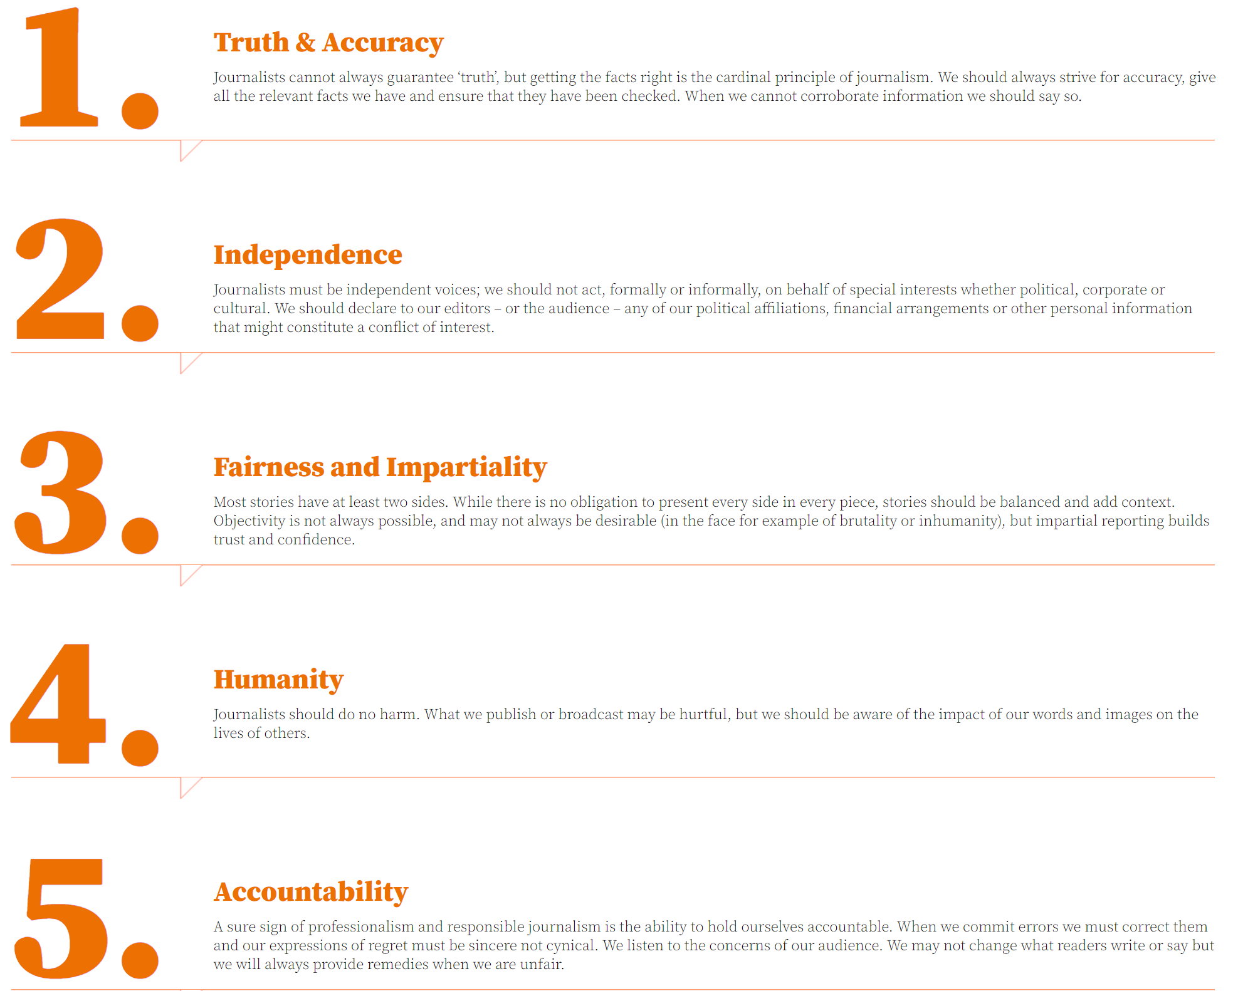

Slide 14

Group Task
Of course, we can also educate ourselves, so that we are better able to tell for ourselves the accuracy of what we are reading!
Before we go on to the next topic we will look at a few examples of news stories and see what you think of them…

Slide 15
Here are three different stories about Ukraine in recent months and the accusation that Russia is building up troops there. Which of these storires seems more credible?
A story by Russia Today a state-controlled international TV network
A story by NBC, one of the US television networks
A story by Reuters, an international journalism organisation

